Slide 1


SMART
OFFICE

Slide 2
CONDUCTED BY
Azward M A (L) CODSE233F - 075
Ilma M H F CODSE233F - 177
Sethulya P H N CODSE233F - 147
Naufel M S CODSE233F - 002
Abeysundera L CODSE233F - 123

Slide 3
TABLE OF
CONTENTS
01
04
Introduction
Benefits
02
05
Features
Limitations
03
06
Recommendations and Conclusion
Circuit Components

Slide 4




INTRODUCTION
These systems are interconnected with smart features.
It utilizes automation, connectivity, and intelligent systems in the workspace.
Features include automated parking, gate opening, smart garden sprinklers, and optimized lighting.
The goal is to maximize efficiency and create an improved workspace experience.

Slide 5
THE FIVE SYSTEMS
A/C On Off System
Security Alarm System
Garden Sprinkler System
Street Light System
Parking System

Slide 6
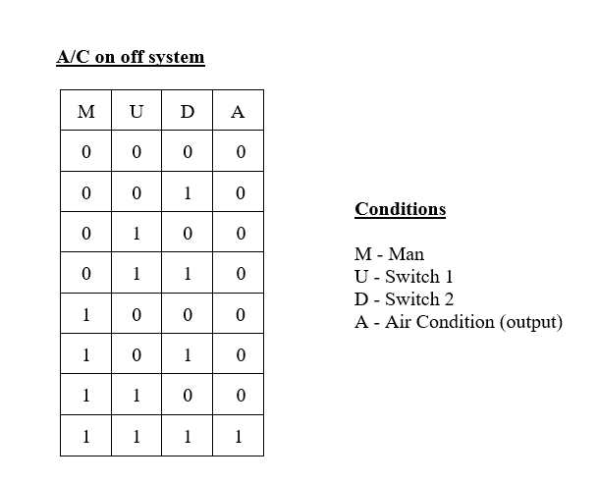
A/C ON OFF SYSTEM
The A/C system operates only when all three conditions (switch one, switch two, and manual) are true. It won't activate otherwise.

Slide 7
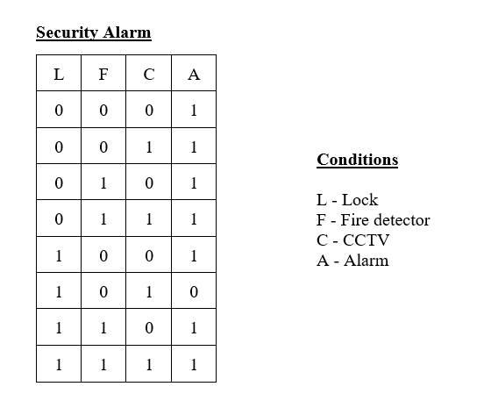
SECURITY ALARM SYSTEM
This alarm system activates during emergencies and integrates a lock, fire detector, and CCTV. It triggers under all circumstances except when only the lock and CCTV conditions are met.

Slide 8
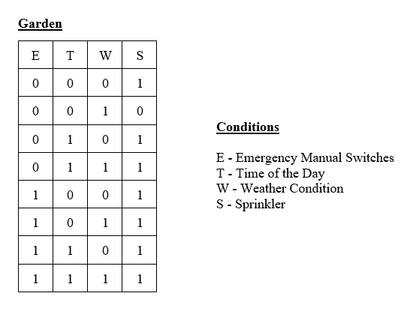
GARDEN SPRINKLER SYSTEM
Office garden lights activate automatically at night or during bad weather. They can also be manually turned on using the emergency switch.

Slide 9
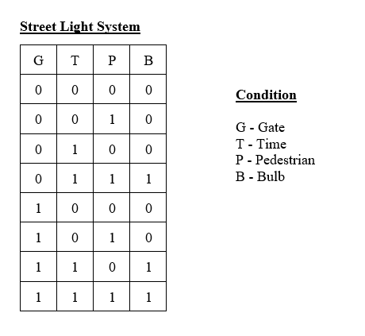
STREET LIGHT SYSTEM
Lights automatically turn on at scheduled times and when the gate is open, a pedestrian or vehicle arrives, or both conditions are met.

Slide 10
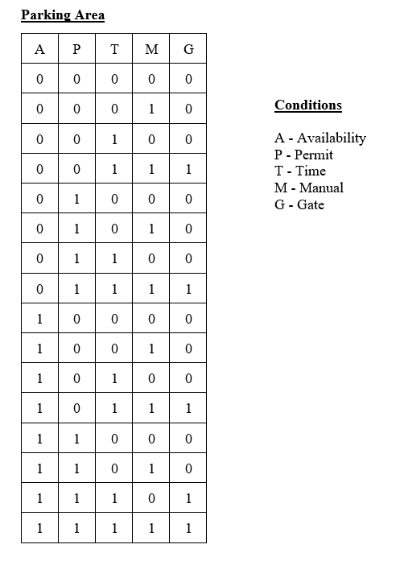
PARKING SYSTEM
The parking gate automatically opens based on five scenarios: parking availability, permit status, time of day, and manual switch activation.

Slide 11
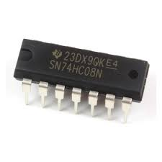
CIRCUIT COMPONENTS
74HC08 IC (AND GATE)
A 14-pin 2-input AND gate with 4 logic gates inside. Each gate outputs 1 when both conditions are met.

Slide 12
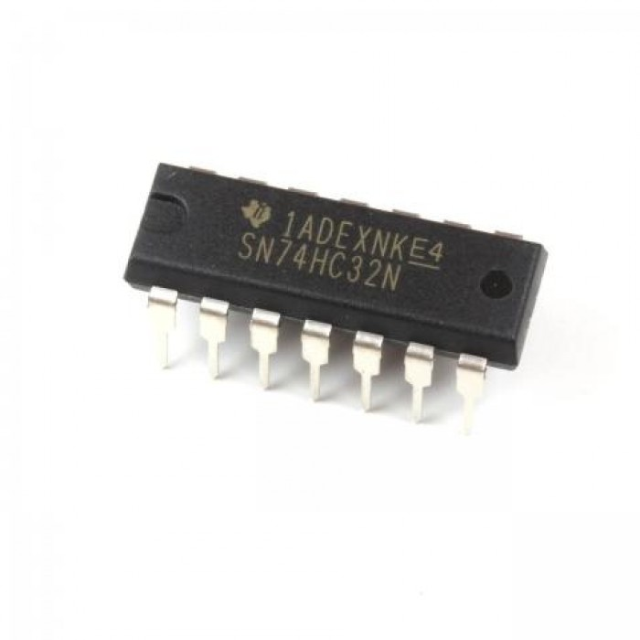
CIRCUIT COMPONENTS
74HC32 IC (OR GATE)
A 14-pin 2-input OR gate with 4 logic gates inside. Each gate outputs 1 when either one of the 2 conditions is met.

Slide 13
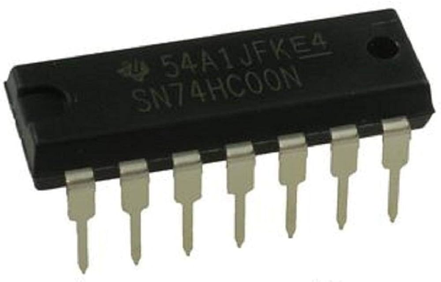
CIRCUIT COMPONENTS
74HC00 IC (NAND GATE)
A 14-pin 2-input NAND gate with 4 logic gates inside. Each gate outputs logic 0 when both inputs are logic 1; otherwise, the output is 1.

Slide 14
CIRCUIT COMPONENTS
74HC04 IC (NOT GATE)
A 14-pin 1-input NOT gate with 6 logic gates inside. Each gate outputs logic 0 when the input is 1, and logic 1 when the input is 0.

Slide 15
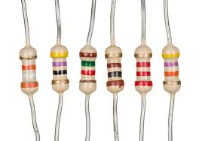
CIRCUIT COMPONENTS
Resistors
Resistors are used in this circuit to reduce the supplied voltage.

Slide 16
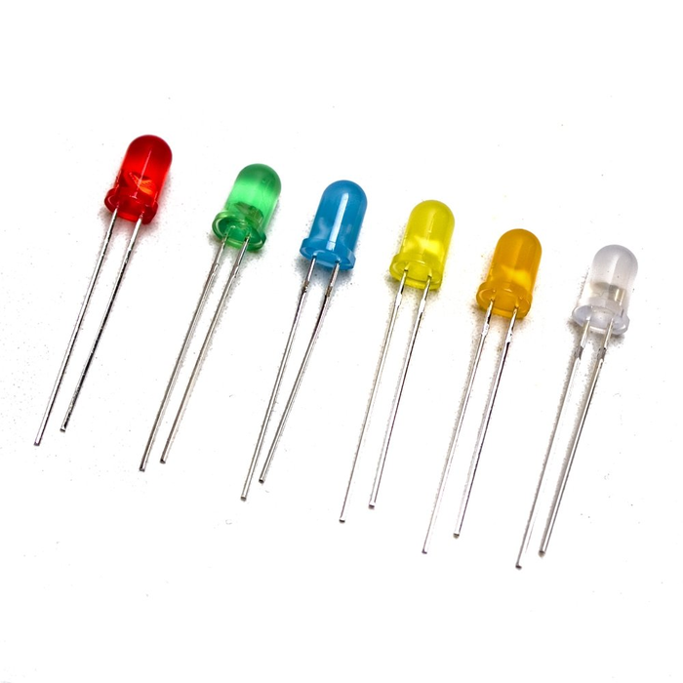
CIRCUIT COMPONENTS
LED Bulbs
These LED bulbs require minimal electricity as they utilize a semiconductor material to conduct electricity.

Slide 17
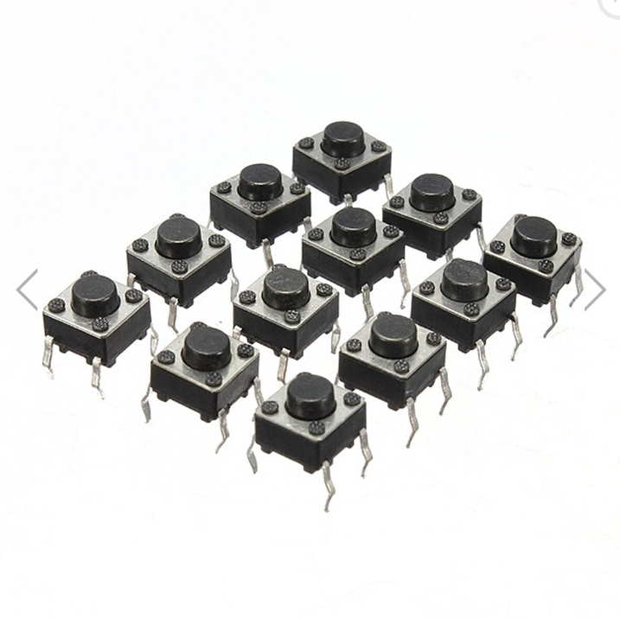
CIRCUIT COMPONENTS
Push Buttons
This is a mechanism that allows the operator to manually control an output by pressing a button.

Slide 18
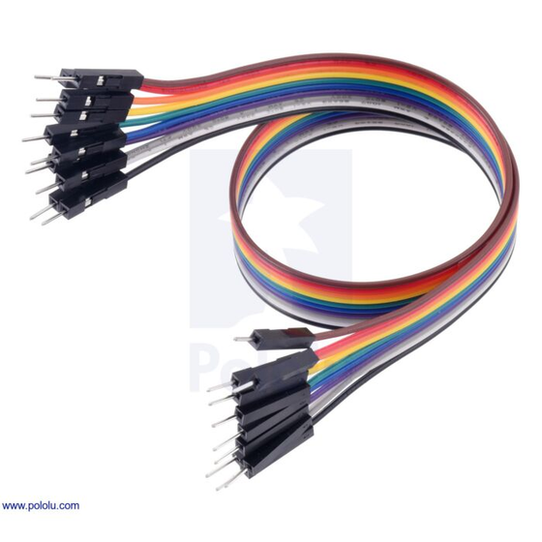
CIRCUIT COMPONENTS
Jumper Cables
These cables are used to make an electrical connection between 2 points on a breadboard.

Slide 19
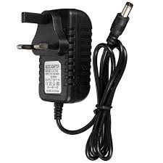
CIRCUIT COMPONENTS
Power Pack
It is used to provide an external power supply to the circuit.

Slide 20
BENEFITS
Revolutionary Concept
Interconnected Systems
Enhanced Efficiency
Optimized Workspace
Focus on Technology

Slide 21
LIMITATIONS
• Implementing motors, motion sensors
• Simplicity of logic gates

Slide 22
RECOMMENDATIONS
Use of sensors on the concept with more smart systems integrated to the model.
Use of more logics will make the system manageable and effective.

Slide 23
CONCLUSION
Enhance the efficiency and escalate the productivity in the work field while reducing labor cost.
Will create a sustainable workspace.

Slide 24




Q & A

Slide 25

THANK
YOU!

